Slide 1
Java OOPS Concepts
Shalini Mittal
Corporate Trainer

Slide 2
What we will cover ?
Procedural vs Object Oriented
OOPS Principles
Map Real world entities
Java Features
Hello Program
Java Architecture
Installation and configuration

Slide 3
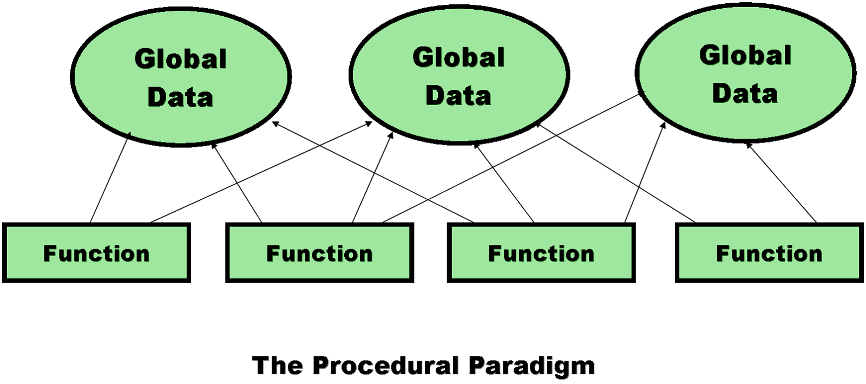
What was there before?
Procedural Language -
No owner for data
Functions are building blocks
Many functions can modify a given block
Resource Deallocation Problems
Notes:
Insufficient support for abstraction –
Abstract Data Type – data and functions
Data – can be modelled as structures in C
Functions - they are global and not tied to these structures

Slide 4
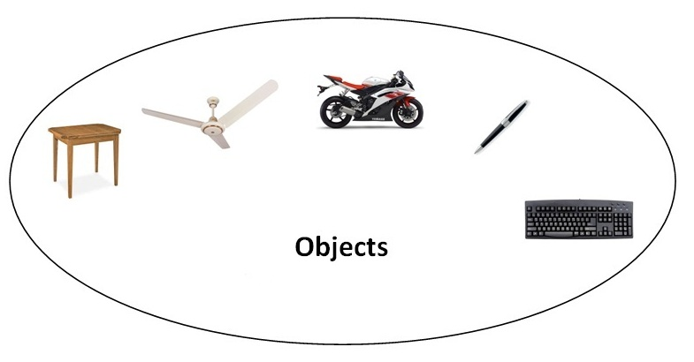
What we Need?
Linking programming languages way human mind thinks.
What we see around us ?
How we define a scenario?

Slide 5
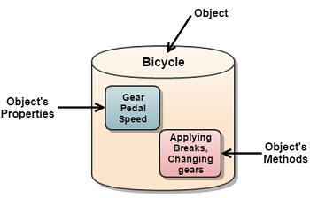
How we define an Object?
Every object has state, unique identity and a behavior.

Slide 6
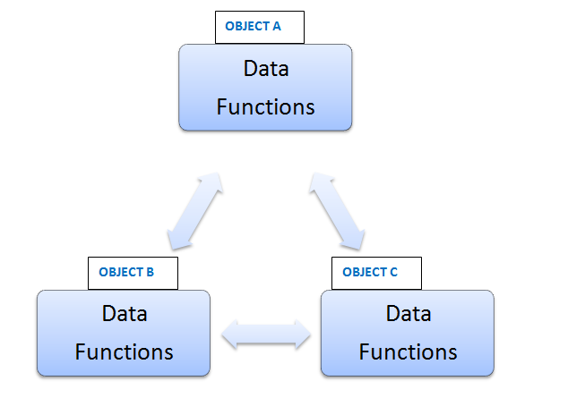
Lets have a look at object oriented paradigm…

Slide 7
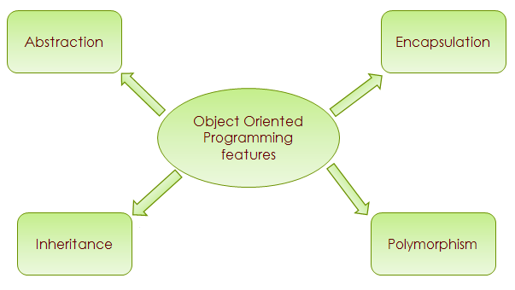
Object Oriented Features :

Slide 8



Abstraction
It’s a simplified view of an object that includes only features one is interested in while hides away the unnecessary details
Data abstraction becomes an abstract data type i.e a user defined type
It is done at analysis level
Employee
Name
Email id
Mob no
Address
Education…
Model
Name
Email
Mob No
Height
Weight…
Patient
Name
Address
Mob No
Blood group
Weight…
Notes:
Insufficient support for abstraction –
Abstract Data Type – data and functions
Data – can be modelled as structures in C
Functions - they are global and not tied to these structures

Slide 9
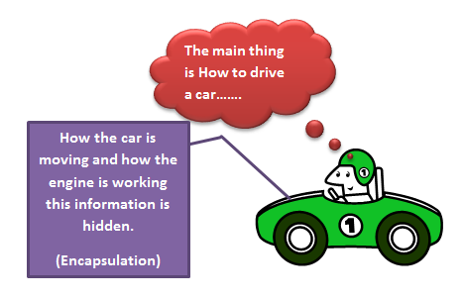
Encapsulation
It is a process of hiding the complexities or implementation details of any object
In object oriented world, it is achieved by combining data and functions into a single unit.
Notes:
Insufficient support for abstraction –
Abstract Data Type – data and functions
Data – can be modelled as structures in C
Functions - they are global and not tied to these structures

Slide 10
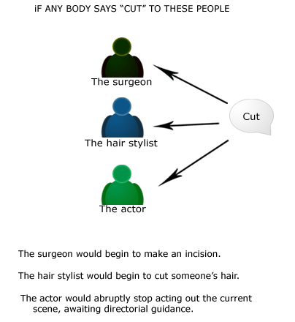
Polymorphism
It is the ability of an object to have different forms.
In object oriented world, it is the ability of different objects to respond to functions of the same name.
There are 2 types of polymorphism:
Static/compile time
Dynamic/sun time
Notes:
Insufficient support for abstraction –
Abstract Data Type – data and functions
Data – can be modelled as structures in C
Functions - they are global and not tied to these structures

Slide 11
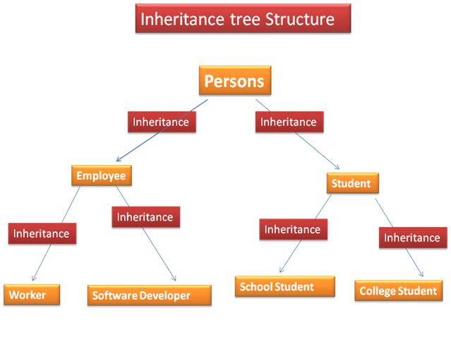
Inheritance
It is the mechanism by which two or more entities/objects that are different but share common features.
It is used for code reusability.
Notes:
Insufficient support for abstraction –
Abstract Data Type – data and functions
Data – can be modelled as structures in C
Functions - they are global and not tied to these structures

Slide 12
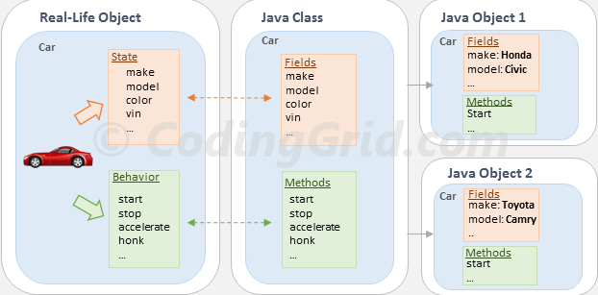
Mapping of objects in programming world..
Notes:
Insufficient support for abstraction –
Abstract Data Type – data and functions
Data – can be modelled as structures in C
Functions - they are global and not tied to these structures

Slide 13
Class and Object
It is a blueprint or user defined data type from which objects are created.
It consist of state (data members) and behavior(member methods) of a real world object.
It represents a set of objects that share common structure and behavior.
An object occupies space and is in a particular state at a point of time.
Notes:
Insufficient support for abstraction –
Abstract Data Type – data and functions
Data – can be modelled as structures in C
Functions - they are global and not tied to these structures

Slide 14
Few things to know before we begin ☺
Why Java is so popular ?
Why it is called Object Oriented Language?
What we mean by Java Program?

Slide 15

So features of Java are … ?
Simple
Object Oriented
Platform Independent (Write Once and Run Anywhere(WORA))
Portable
Secured
Compiled & Interpreted
Robust
Multithreaded
Open Source

Slide 16
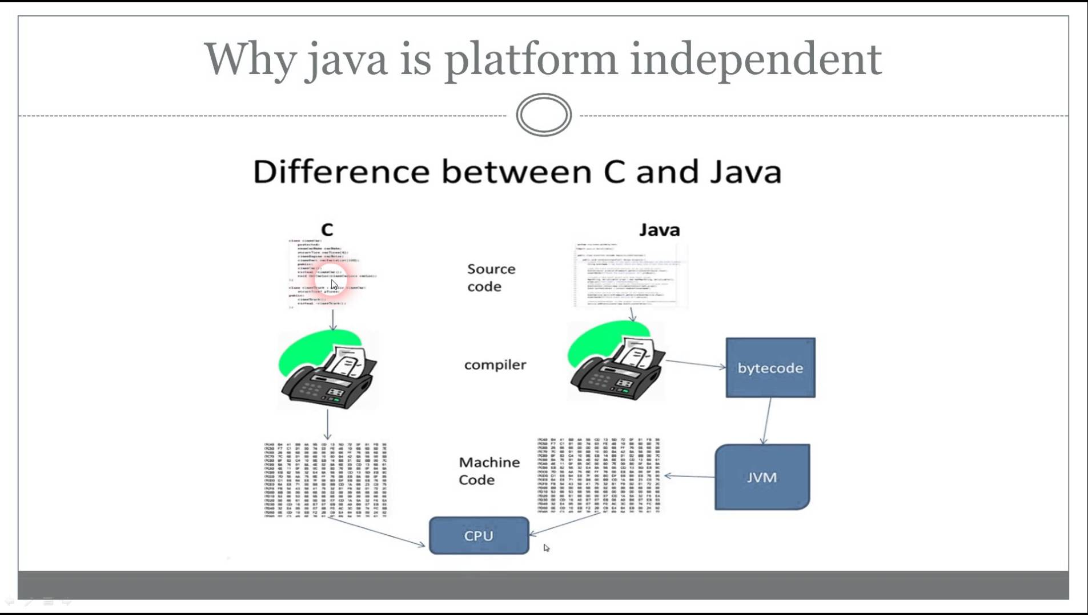

Slide 17
Platform Independence
JRE
Window’s workspace
JRE
Java code
(.java file)
Java Byte code
(.class file)
Java Compiler
Linux workspace
JRE
Solaris workspace
Notes:
JVM
JVM (Java Virtual Machine) is an abstract machine. It is a specification that provides runtime environment in which java bytecode can be executed.
JVMs are available for many hardware and software platforms. JVM, JRE and JDK are platform dependent because configuration of each OS differs. But, Java is platform independent.
The JVM performs following main tasks:
Loads code
Verifies code
Executes code
Provides runtime environment

Slide 18
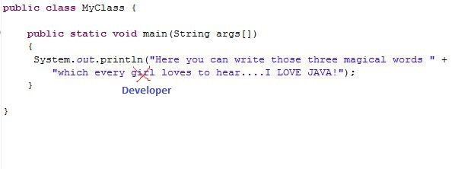
Let’s start swimming….

Slide 19
Java Architecture:
Source File (HelloWorld.java)
JVM
Class Loader
Compiler (javac)
Byte Code Verifier
Interpreter
JIT Code Generator
Machine Code or Byte code (HelloWorld.class)
Runtime
Operating System
Hardware

Slide 20
How JDK, JRE and JVM are related?
JRE
JVM
+
Library
Classes
Development
Tools
+
JDK

Slide 21
Installation & configuration
Install it from Oracle.com or Java.com
Set Path variable to:
set PATH=C:\Program Files\Java\jdk1.5.0_07\bin
Compile the program.
Run the program.

Slide 22

Any Question ?

Slide 23
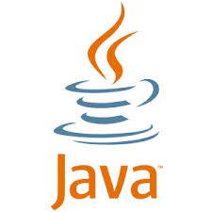
Thank you !

